Slide 1
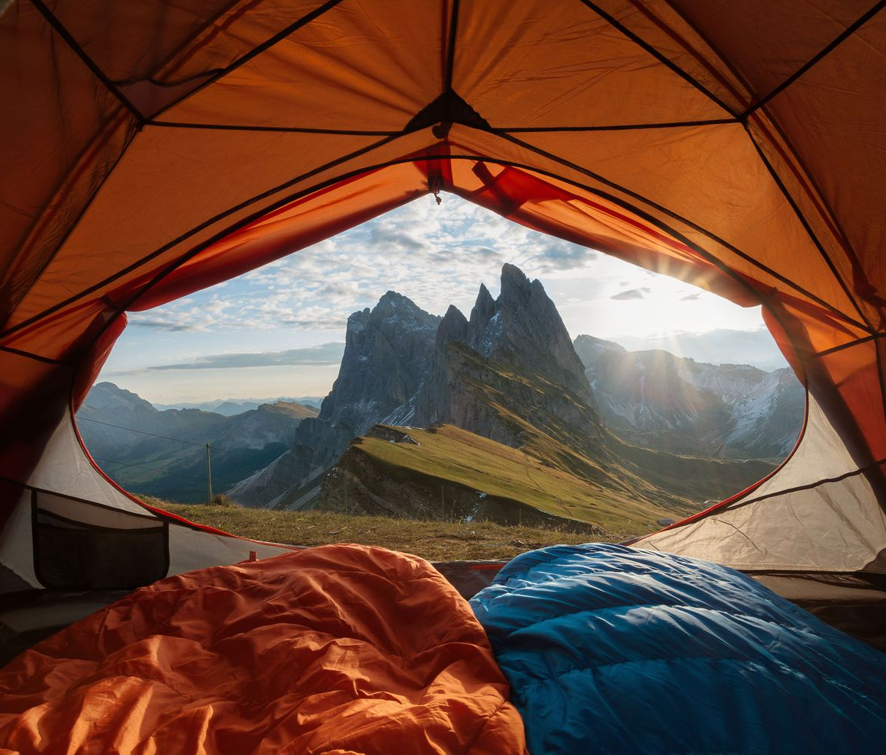
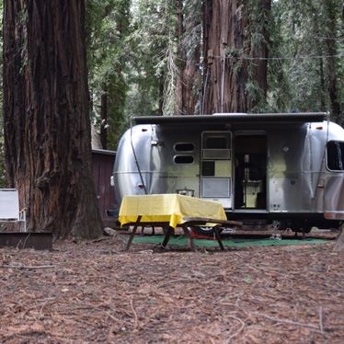
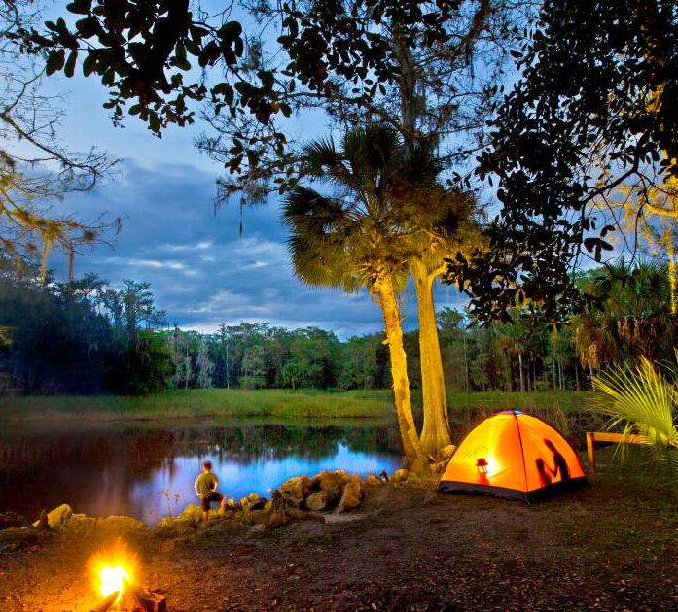
What makes a camping site popular?
Definition of Popular:
High Demand (# of reservations/# of campsites)
Advance Booking (days)
Average Number of Nights Camping (days)
Types of Campsites (tenting, remote, group, RV&Structures)
Recreational Activities

Slide 2
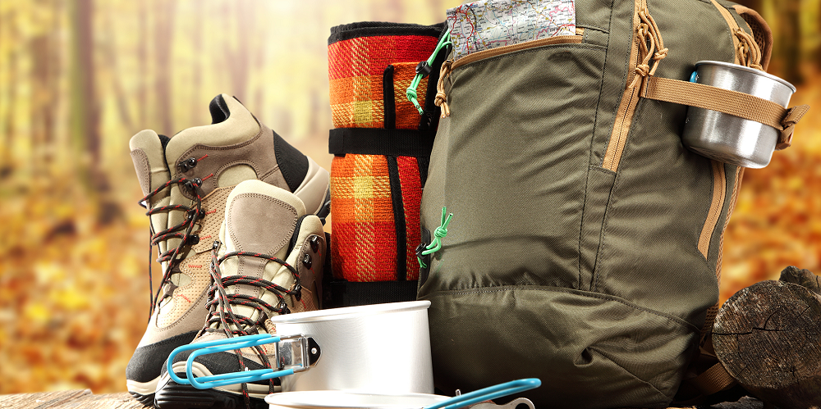
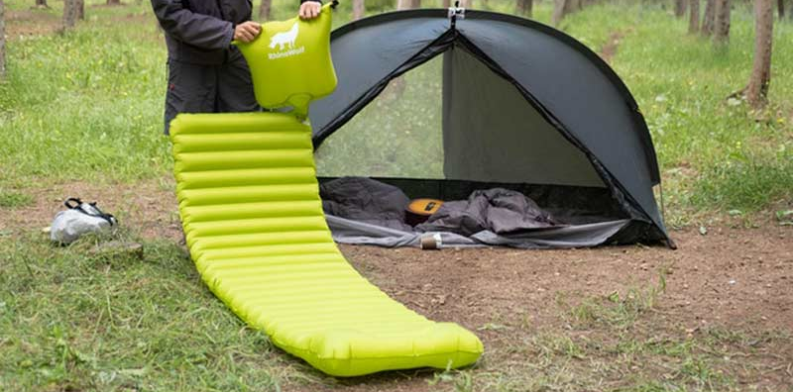
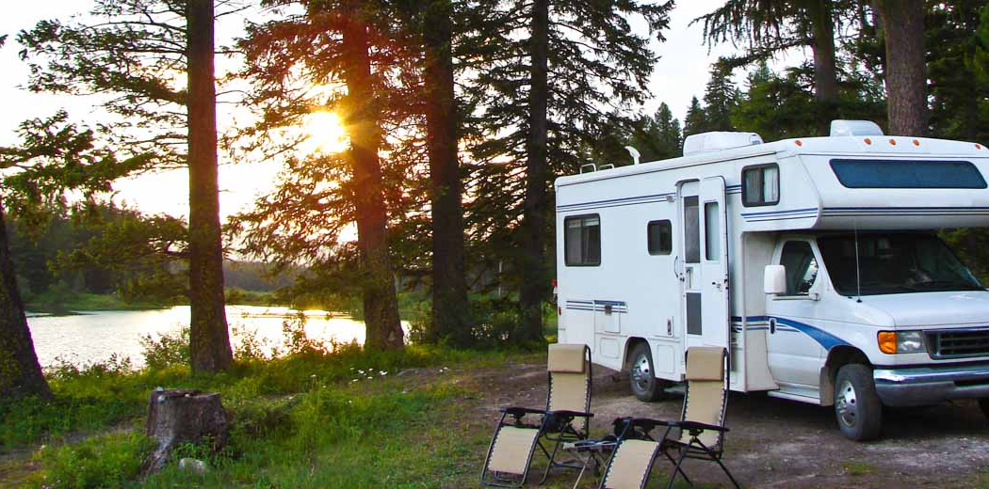
US Economy – Covid19
2019
2020-21
Campgrounds and RV parks generate $25.6 bn/year
Campers spend over $31bn/year:
Camping gear
Accessories
Vehicles
91 million campers/year
Covid19 has increased camping popularity
Social distancing
Local traveling
Newcomers entering camping

Slide 3
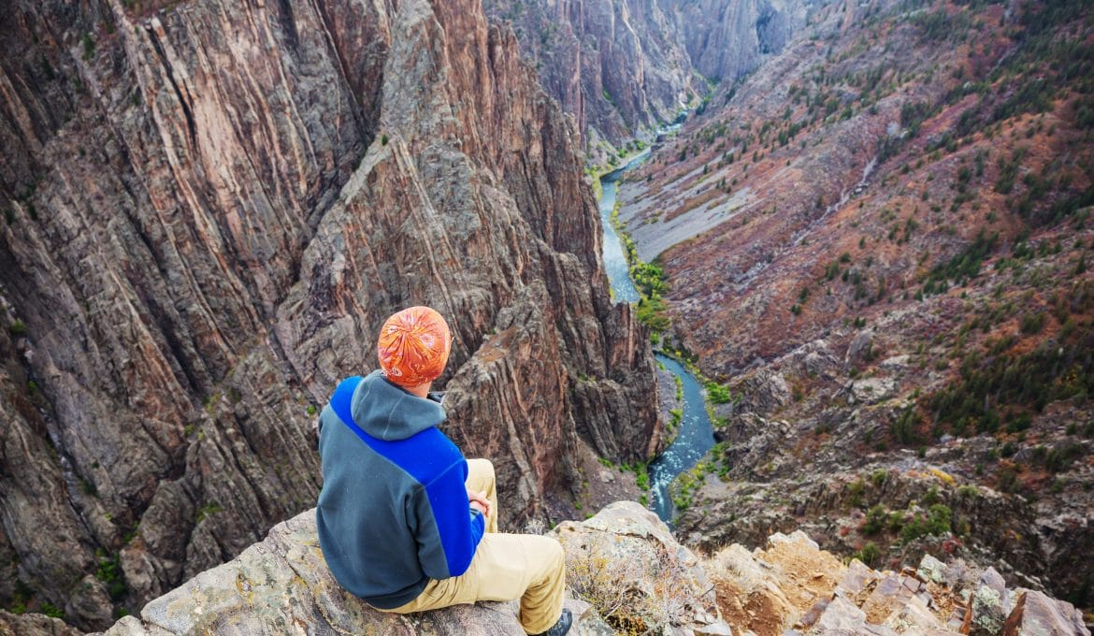
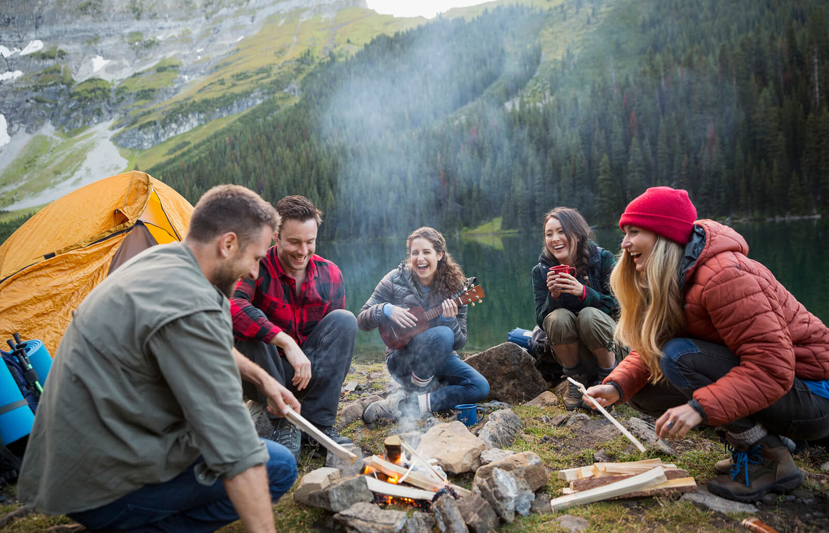
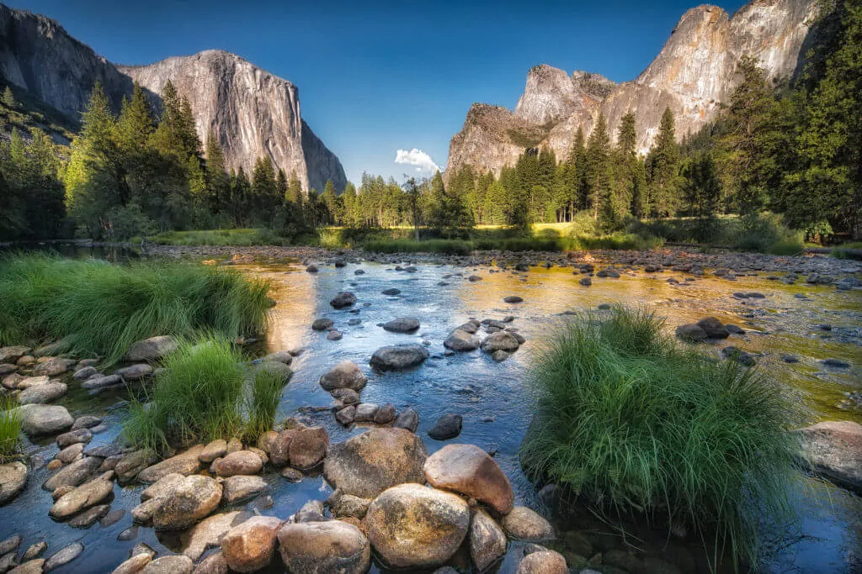
Research Findings
High Demand:
“Destination” Campgrounds (Yosemite)
Remote and Group site (privacy)
Tenting > RV-Cabins-Yurts
Activities:
Historical and Cultural Sites
Photography
Stargazing
Wilderness

